Slide 1
Demo Model Presentation
Best Time of Supply Development for SLCDPU based Reliability using WEAP model
March 24th, 2016
Hessam Tavakol, Yonas Tsegay, Seungyub Lee

Slide 2
Introduction
Project Overview
Model Overview
Primarily Result
Contents
Notes:
We spend most of time to collect data and still the data isn’t ready yet. We request the data for SLCDPU and waiting for 3 weeks. So our presentation is kind of describing what we will do and we are doing.

Slide 3

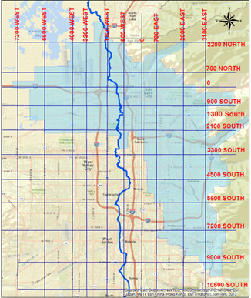
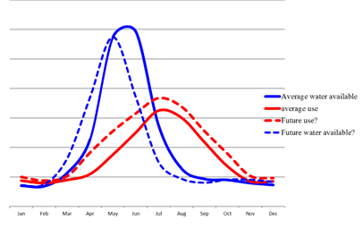
Introduction
Stakeholder
Name
Salt Lake City Department of Public Utilities (SLCDPU)
Missions
Delivering high quality of drinking water
Managing flood control and storm water
Collecting and treating wastewater to standards that exceed EPA regulations
Maintaining and enhancing public street lighting
Service area
195 square miles
345,000 residential customers
92,000 connections within Salt Lake City, Cottonwood Heights, Holladay, Millcreek Township, and portions of Murray, Midvale, and south Salt Lake
Current water source*
60% from river system
25% from reservoir system
15% from groundwater
Potential management problems
Earlier and decreased amount of snow melt due to climate change
Increase in demand due to population growth
*Numbers based on “2014 Salt lake City Water Conservation Master Plan”
Notes:
Again, since the proper data isn’t covered yet, the current water sources are estimated by the 2014 slat lake city water conservation master plan report

Slide 4
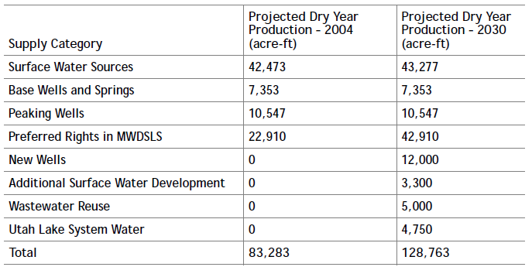
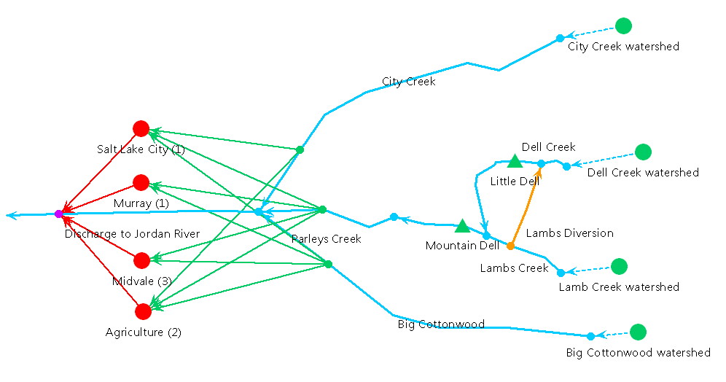
Project Overview
Recommended options for water resources from SLCDPU
Additional Water Supply
Source Reliability
System Production Capacity
Timing of Supply Development
Conservation
Global Climate Change
Current Model
Considers river and reservoir system
Projected precipitation data from CMIP3 and CMIP5 is used
Also the climate change factor is in consideration to create different scenario
Increased demand is considered by the population growth rate
Reliability analysis by using built-in function in WEAP
Groundwater system is not in consideration
Conservation strategies are not in consideration as well
Timing of supply development is out of scope
Milestones
Jan 21th
Feb 23rd
Apr 12th
April 19th
Apr 26th
Initialize project
outline
WEAP
Modeling
Results Analysis & Revise Model
Prepare final presentation
Data Collection
Notes:
Out project object is trying to provide the adequate model that can solve their concerns in context of their recommendation option for the water resources
System Production Capacity – It is estimated that the ultimate peak day demand in the City will be approximately 40 mgd greater than its current production capacity. If 5 mgd of additional capacity is developed through new surface water sources, it is recommended that an additional 35 mgd be developed through new ground water or other sources.

Slide 5

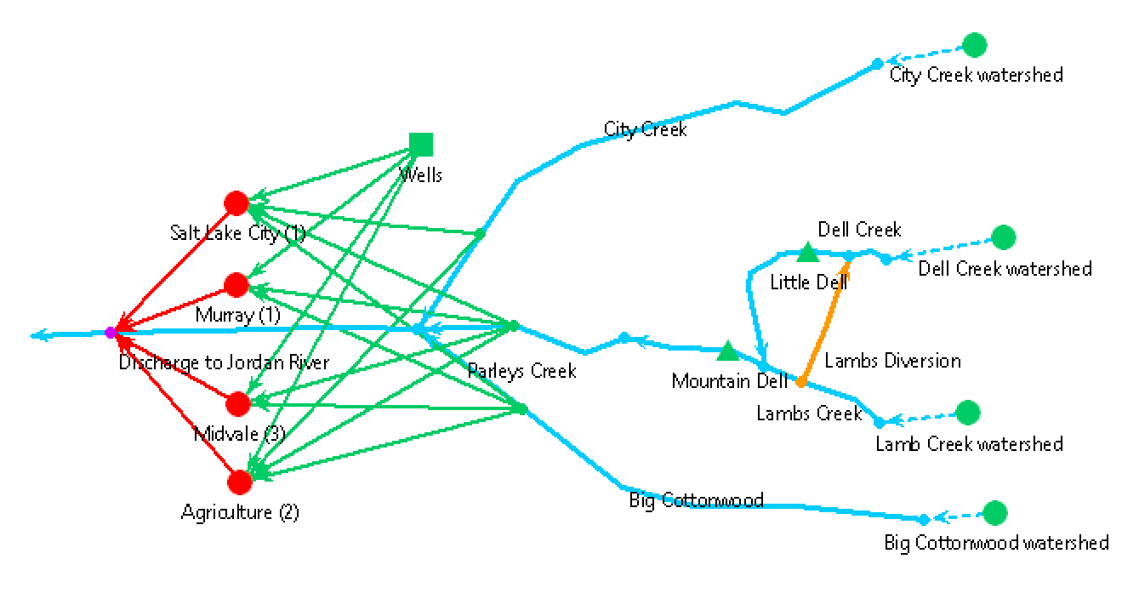
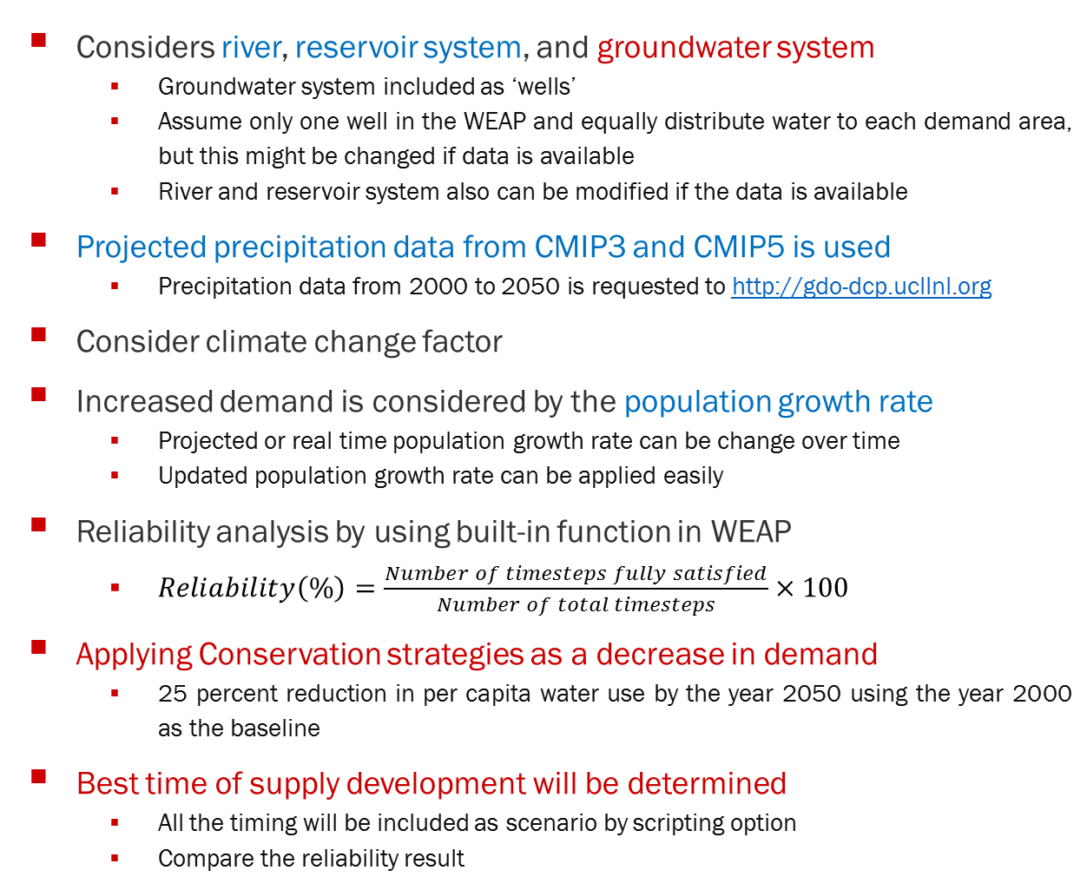
Model Overview
Considers river, reservoir system, and groundwater system
Groundwater system included as ‘wells’
Assume only one well in the WEAP and equally distribute water to each demand area, but this might be changed if data is available
River and reservoir system also can be modified if the data is available
Projected precipitation data from CMIP3 and CMIP5 is used
Precipitation data from 2000 to 2050 is requested to http://gdo-dcp.ucllnl.org
Consider climate change factor
Increased demand is considered by the population growth rate
Projected or real time population growth rate can be change over time
Updated population growth rate can be applied easily
Reliability analysis by using built-in function in WEAP
$Reliability\left(\%\right)=\frac{Number of timesteps fully satisfied}{Number of total timesteps}×100$
Applying Conservation strategies as a decrease in demand
25 percent reduction in per capita water use by the year 2050 using the year 2000 as the baseline
Best time of supply development will be determined
All the timing will be included as scenario by scripting option
Compare the reliability result
Notes:
First, simulating period is same for existing and planned not only due to lack of data, but also to check the actual impact of new wells.
Second, all the springs and wells are combined in one simple source as shown in Figure 3.
Third, storage capacity if assumed to be infinite, and initial storage, maximum withdrawal, and natural recharge is assumed to be same, and 2.2 for existing and 3.7 for planned both in million cubic meter.

Slide 6
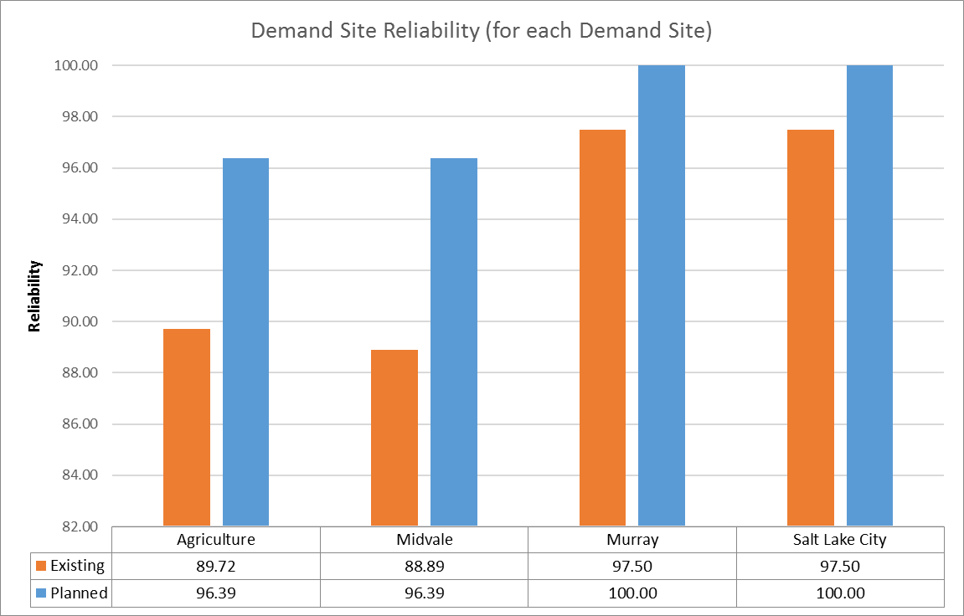
Primarily Result
Notes:
This actually shows the planned groundwater can increase the reliability compared to the existing under the demand increase scenario.

